Slide 1
Cohesion and Coupling
Software Engineering-22CSC21
B.E-CSE/V-SEM

Slide 2
Cohesion and Coupling
different aspects of how parts of a software system are related

Slide 3
Cohesion
Cohesion in software engineering refers to how closely related the responsibilities and functions of a single module.
In other words, it measures how well the elements within a module work together to achieve a single purpose.
High cohesion means that a module has a clear, focused purpose and its parts are directly related to that purpose. This is desirable because highly cohesive modules are easier to understand, maintain, and test.
Example : Consider a module that handles all the operations related to user authentication, such as logging in, logging out, and managing passwords. If these tasks are all contained within one module, that module has high cohesion.

Slide 4
Coupling
Coupling in software engineering refers to the degree of interdependence between two or more modules in a system.
It indicates how much one module relies on the details of another. Low coupling is preferable because it means changes in one module are less likely to impact others, making the system more flexible and easier to maintain.
Example : If a user authentication module is designed in such a way that it can work independently of other modules, such as the user profile or the database, then it has low coupling.
This independence means that changes to the authentication module won't necessitate changes to other parts of the system.

Slide 5
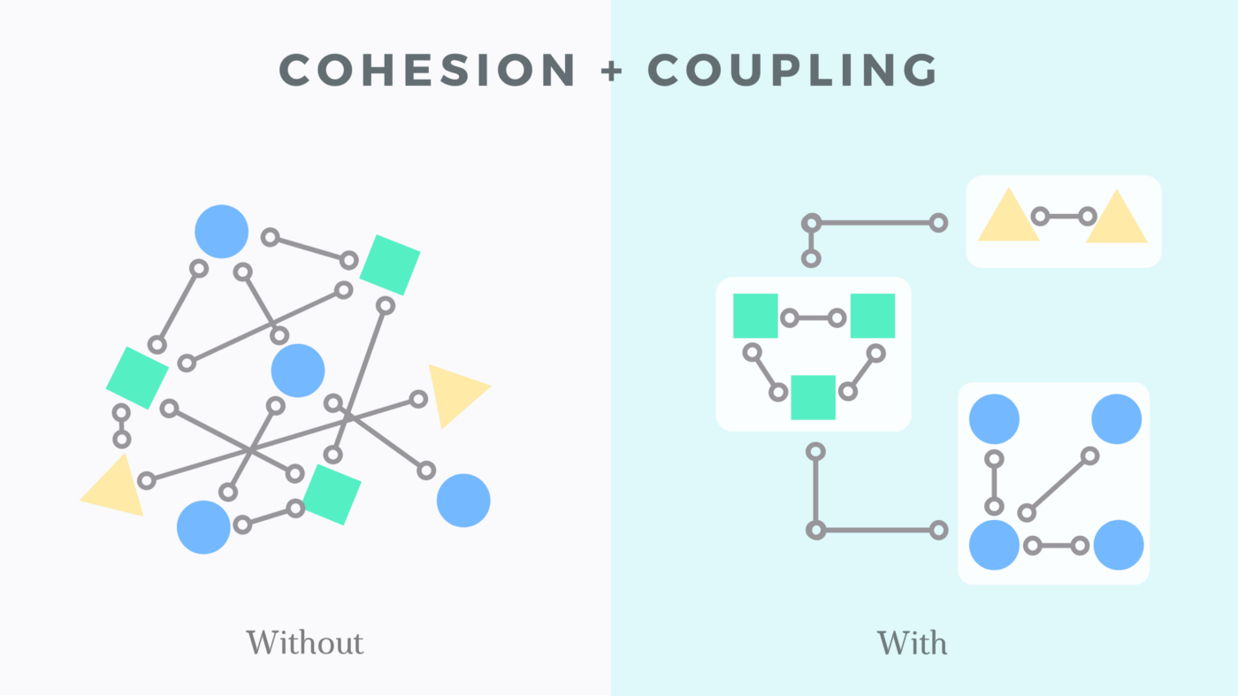

Slide 6
Key Differences
Focus: Cohesion is about how closely related the elements within a module are. Coupling is about the relationships between different modules and how much they depend on each other.
Desirability: High cohesion is desirable because it means a module is focused on a specific task. Low coupling is also desirable because it allows modules to be changed without affecting others.
Maintenance: Systems with high cohesion and low coupling are easier to maintain and expand, as changes in one module are less likely to cause issues in others.

Slide 7
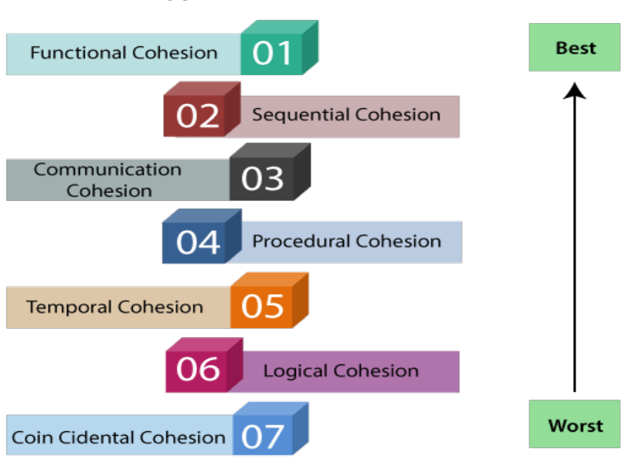
Types of Cohesion

Slide 8
1. Functional Cohesion
On of the types of cohesion in software engineering is functional cohesion that occurs when the elements within a module perform a single, well-defined task or a function.
All the elements within the module contribute to achieving the same objective.
This type of cohesion is considered the most desirable & strongest.
Example - reading transaction records, cosine angle computation, seat assignment to an airline passenger, etc

Slide 9
2. Sequential Cohesion
Sequential cohesion occurs when the elements within a module are arranged in a specific sequence, with the output of one element serves as the input for the next element.
The elements are executed in a step-by-step manner to achieve a particular functionality.
Example - cross-validated records and formatting of a module, raw records usage, formatting of raw records, cross-validation of fields in raw records, etc.

Slide 10
3. Communicational Cohesion
Communicational cohesion is another one of the types of cohesion in software engineering occurs when the elements within a module operate on the same input data or share data through parameters.
The elements within the module work together by passing data to each other.
It is weaker than sequential cohesion.
Example - usage of a customer account number, finding the name of the customer, the loan balance of the customer, etc.

Slide 11
4. Procedural Cohesion
Procedural cohesion occurs when the elements within a module are grouped based on a specific sequence of actions or steps.
This type of cohesion is weaker than the communicational cohesion.
Example - Read, write, edit of the module, zero padding to the numeric fields, returning records, etc.

Slide 12
5. Temporal Cohesion
Temporal cohesion occurs when the elements within a module are executed at the same time or within the same timeframe.
It is considered weaker than the procedural cohesion.
Example - Setting the counter to zero, opening the student file, clearing the variables of error messages, initializing the array, etc.

Slide 13
6. Logical Cohesion
Logical cohesion occurs when the elements within a module are logically related, but do not fit into any other cohesion types.
It is not strong as other cohesion types.
Example - When a component reads inputs from tape, disk, and network, etc.

Slide 14
7. Coincidental Cohesion
Coincidental cohesion occurs when the elements are not related to each other.
Example - Module for miscellaneous functions, customer record usage, displaying of customer records, calculation of total sales, and reading the transaction record, etc.

Slide 15
Coupling
Coupling in software engineering refers to the degree of interdependence & connection between modules or components within a software system.
Two modules are said to have high coupling if they are closely connected.
In simple words, coupling is not just about modules, but the connection between modules and the degree of interaction or interdependence between the two modules.
If two modules contain a good amount of data, then they are highly interdependent.

Slide 16
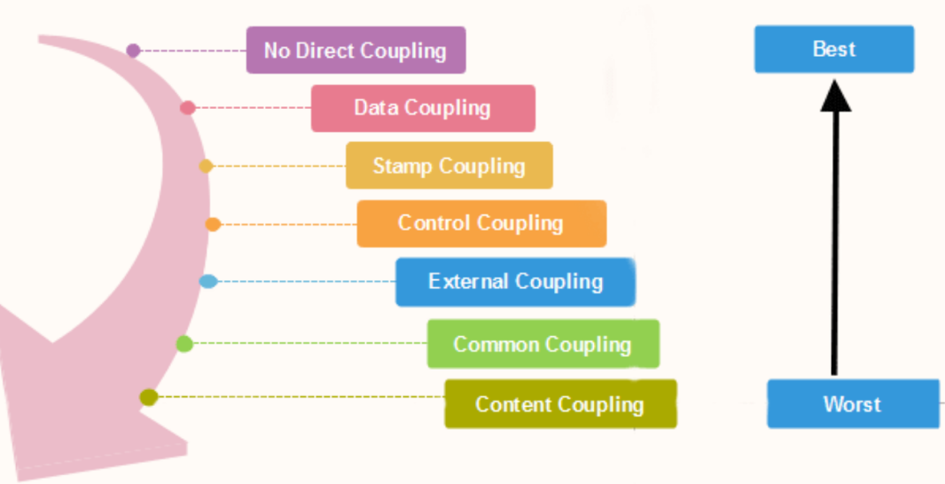
Types of Coupling

Slide 17
1. Data Coupling
Data coupling is a type of coupling in software engineering that occurs when modules share data through parameters or arguments.
Each module maintains its own data and does not exactly access or modify the data of other modules.
This type of coupling promotes encapsulation & module interdependence.

Slide 18
2. Stamp Coupling
Stamp coupling is a weaker form of coupling where modules share a composite data structure, but not all the elements are used by each module.
As the data and elements are pre-organized and well-placed beforehand, no junk or unused data is shared or passed between the two coupling modules which improves the efficiency of the modules.

Slide 19
3. Control Coupling
occurs when one module controls the behavior of another module.
This type of coupling implies that one module has knowledge of internal workings & decisions or another module, that makes the code more difficult to maintain.

Slide 20
4. External Coupling
External coupling measures the degree to which the system relies on external entities to fulfill its functionality or interact with the external environment.
Low external coupling - Changes in the external entities have little impact on internal implementation of the system.
Medium external coupling - Changes in the external entities require some modifications within the system to accomodate new interfaces.
High external coupling - Changes in the external entities have a substantial impact on internal implementation of the system, requiring extensive modifications.

Slide 21
5. Common Coupling
Common coupling occurs when two or more modules in the system share global data.
The modules can access & manipulate the same global variables & the data structures.

Slide 22
6. Content Coupling
Content coupling is another type of coupling in software engineering that occurs when one module directly accesses or modifies the content of another module.
This type of coupling is strong & undesirable since it tightly couples the modules, making them highly independent on each other's implementation.

Slide 23
Cohesion metrics
1. Lack of Cohesion of Methods (LCOM)
Calculated by the number of disjoint sets of methods in the module.
A higher LCOM value indicates lower cohesion.
2. LCOM2
Calculated by the number of disjoint sets of methods - but provides a more refined measure of cohesion compared to LCOM.
3. Tight Class Cohesion (TCC)
Represents the proportion of method pairs that access the same attributes.
A higher TCC value indicates stronger cohesion in software engineering.

Slide 24
Coupling metrics
1. Coupling Between Objects (CBO)
CBO measures the no. of other classes or objects to which a class is coupled.
Higher CBO values suggest increased coupling & reduced reusability.
2. Response For a Class (RFC)
RFC measures the no. of methods in a class that can be executed in response to a message received by an object of that class.
Higher RFC values indicate higher complexity.
3. Depth of Inheritance Tree (DIT)
DIT measures the no. of levels in the inheritance hierarchy for a class.
Higher DIT values suggest a deeper inheritance tree & increased coupling.

Slide 25
Function Oriented Design
The design process for software systems often has two levels. At the first level, the focus is on deciding which modules are needed for the system based on SRS (Software Requirement Specification) and how the modules should be interconnected.
Function Oriented Design is an approach to software design where the design is decomposed into a set of interacting units where each unit has a clearly defined function.

Slide 26
Function Oriented Design: Structured Charts
A structure chart is a diagram that can be created using a data flow diagram as a starting point. When we compare Structure Chart to DFD.
The system is divided into several components, each of which functions separately.
Structure charts represent the functions and sub-functions of each of these modules.
It illustrates the hierarchical layout of modules. A distinct task is carried out at each level.
In the Hierarchical structure of Structure Charts, the Components are read from left to right and from top to bottom.

Slide 27
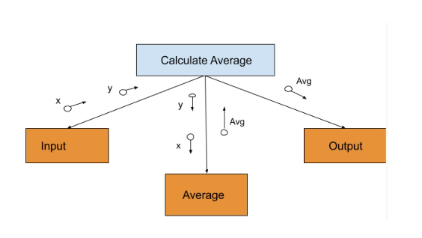
Function Oriented Design: Structured Charts
dim x, y as integer
sub calculateAverage()
dim avg as integer
inputNums()
avg = average(x,y)
outputAvg(avg)
end sub
function average(a,b)
return (a + b) / 2
end function
sub inputNums()
x = console.readline()
y = console.readline()
end sub
sub outputAvg(z)
console.writeline("average = " & z)
end sub

Slide 28
Structured Charts
representation of the hierarchy of functions within a program. It shows the functions, the data that flows between them (as parameters and return values) and gives a general indication of decisions and loops within the processing

Slide 29
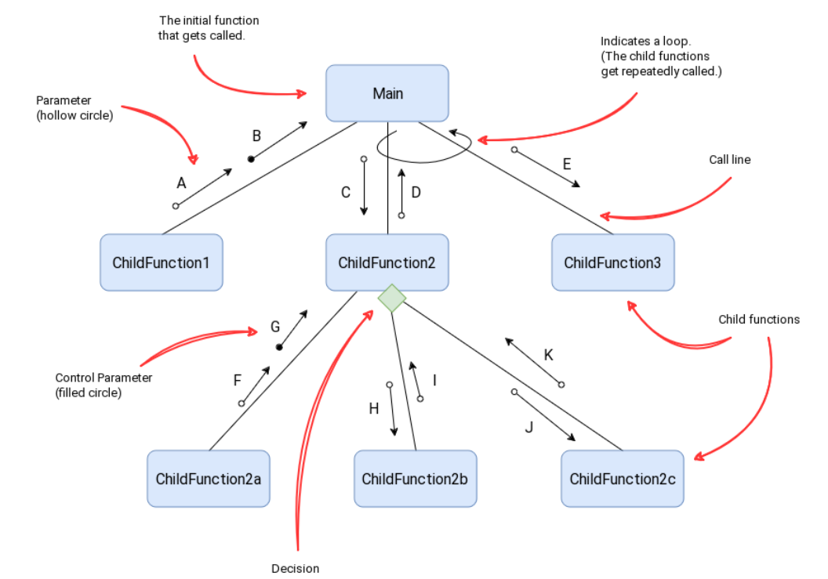
Structures charts: elements
A loop is indicated with a curved arrow and shows that the function, or functions, get called repeatedly. We don't list the criteria for the decision on the structure chart, only that is it repeated.
A decision is indicated with a diamond. Every child function coming from the same decision block is indicated under the same diamond.
Parameters are the data which gets passed down to and back from the functions. An open circle indicates plain data which is processed. A filled circle indicates a parameter which impacts the operation of a loop or decision in the diagram. This is referred to as a flag or control variable.

Slide 30
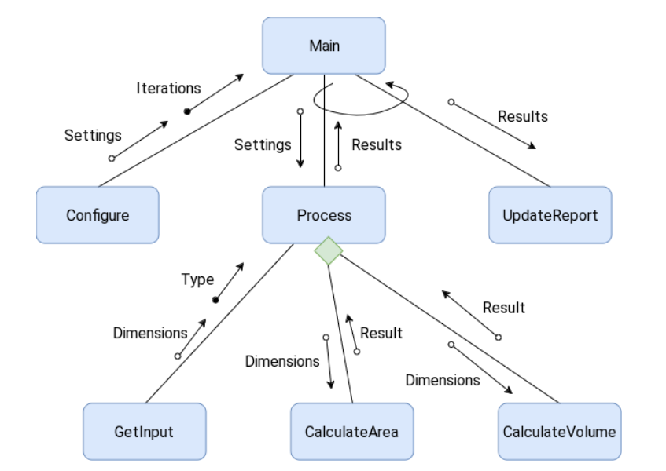
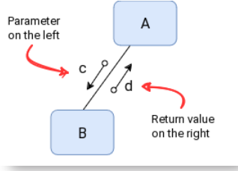
Structured charts: example

Slide 31
Construct Structure Chart for the below code:
BEGIN
Get width
WHILE width > 0
perimeter = calculate_perimeter(width)
Display permimeter
area = calculate_area(width)
Display area
Get width
ENDWHILE
END
BEGIN calculate_perimeter (length)
perimeter = length * 4
Return perimeter
END calculate_perimeter
BEGIN calculate_area (length)
area = length * length
Return area
END calculate_area

Slide 32
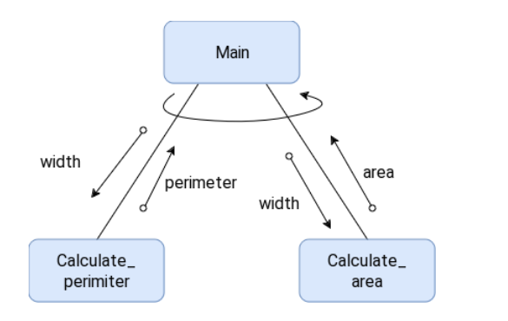
Ex:

Slide 33
ARCHITECTURAL STYLES
Architectural style describes a system category that encompasses
a set of components (e.g., a database, computational modules) that perform a function required by a system;
a set of connectors that enable “communication, coordination and cooperation” among components;
constraints that define how components can be integrated to form the system; and
semantic models that enable a designer to understand the overall properties of a system by analyzing the known properties of its constituent parts.

Slide 34
Pattern Vs Style
a pattern differs from a style in a number of fundamental ways:
the scope of a pattern is less broad, focusing on one aspect of the architecture rather than the architecture in its entirety;
a pattern imposes a rule on the architecture, describing how the software will handle some aspect of its functionality at the infrastructure level (e.g., concurrency)
architectural patterns tend to address specific behavioral issues within the context of the architecture

Slide 35
A Brief Taxonomy of Architectural Styles
Data-centered architectures
Data-flow architectures
Call and return architectures
Object-oriented architectures
Layered architectures

Slide 36
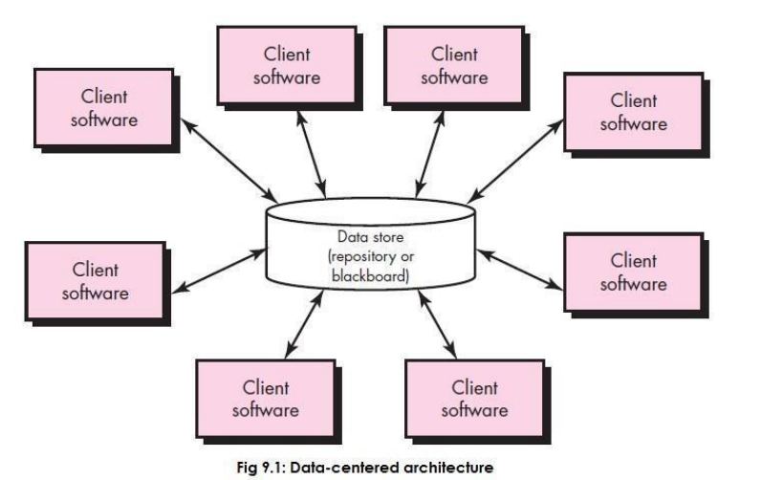
1. Data-centered architectures
A data store (e.g., a file or database) resides at the center of this architecture and is accessed frequently by other components that update, add, delete, or otherwise modify data within the store.
Figure 9.1 illustrates a typical data-centered style.

Slide 37
2. Data-flow architectures
This architecture is applied when input data are to be transformed through a series of computational or manipulative components into output data.
A pipe-and-filter pattern (Figure 9.2) has a set of components, called filters, connected by pipes that transmit data from one component to the next.
Each filter works independently of those components upstream and downstream, is designed to expect data input of a certain form, and produces data output(to the next filter) of a specified form.

Slide 38
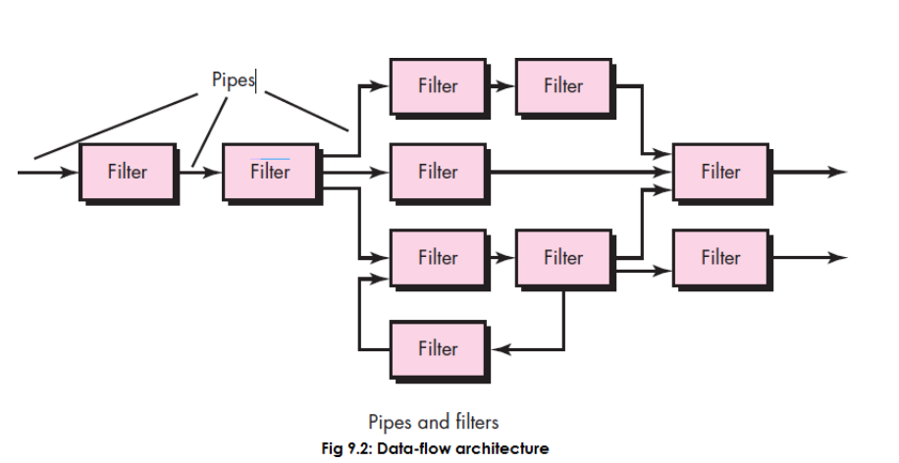
2. Data-flow architectures

Slide 39
3. Call and return architectures
enables us to achieve a program structure that is relatively easy to modify and scale.
A number of substyles exist within this category:
Main program/subprogram architectures: This classic program structure decomposes function into a control hierarchy where a “main” program invokes a number of program components that in turn may invoke still other components.
Figure 9.3 illustrates an architecture of this type.
ii) Remote procedure call architectures: The components of a main program/subprogram architecture are distributed across multiple computers on a network.

Slide 40
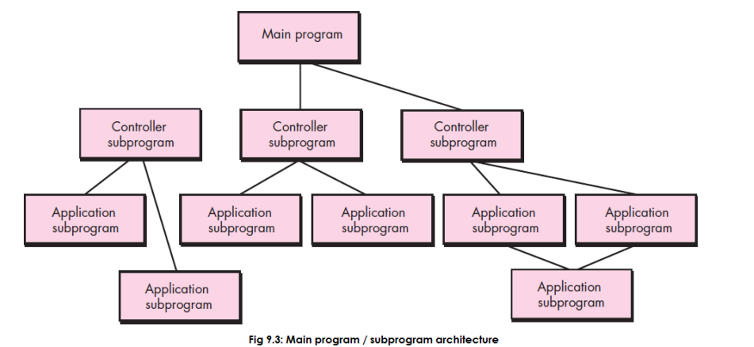
3. Call and return architectures
Main program/subprogram architectures

Slide 41
4. Object-oriented architectures
The components of a system encapsulate data and the operations that must be applied to manipulate the data.
Communication and coordination between components are accomplished via message passing.

Slide 42
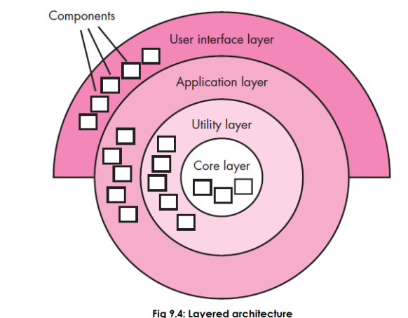
5. Layered architectures
The basic structure of a layered architecture is illustrated in Figure 9.4.
A number of different layers are defined, each accomplishing operations that progressively become closer to the machine instruction set.
At the outer layer, components service user interface operations.
At the inner layer, components perform operating system interfacing. Intermediate layers provide utility services and application software functions

